Slide 1
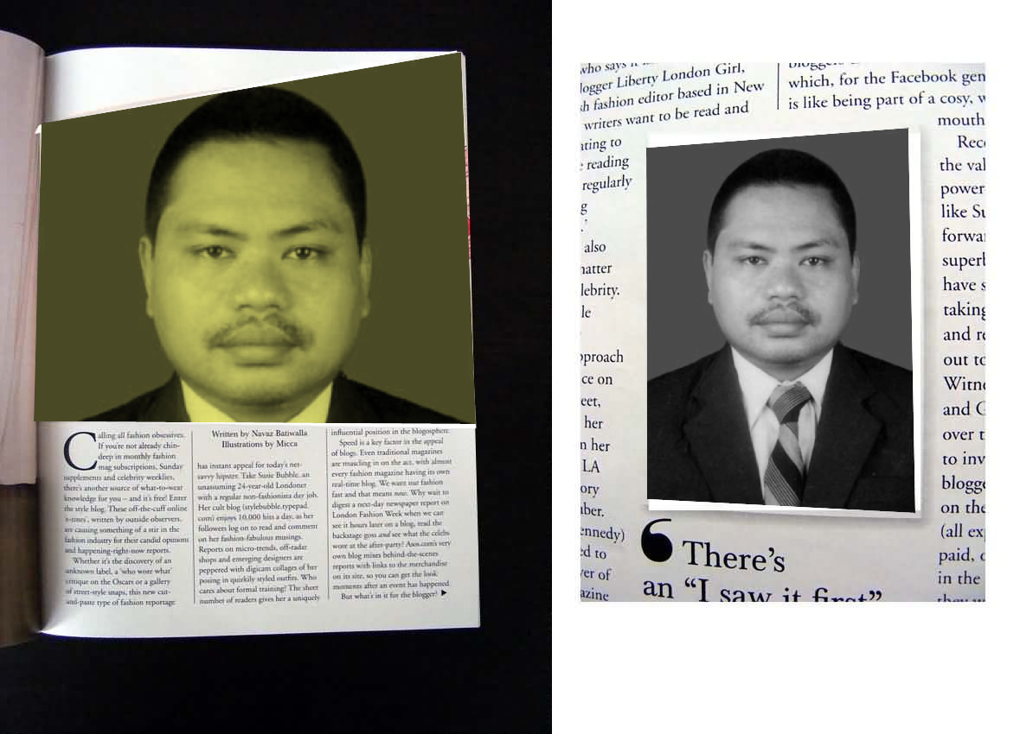
KUMPULAN
PERLENGKAPAN KOMPUTER
MAKSUM
Email : ibenk_mas@yahoo.com
Blog : www.smama’arifkarangawen.blogsport.com

Slide 2
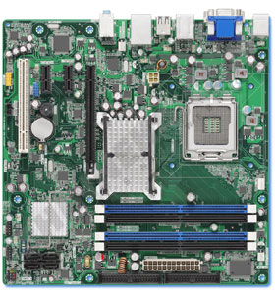
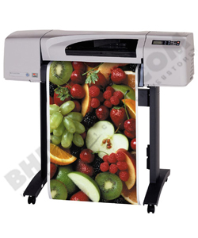
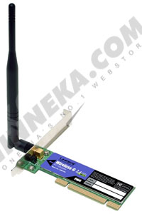

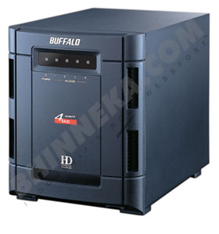

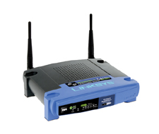

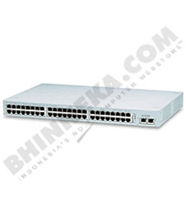

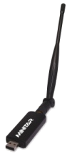
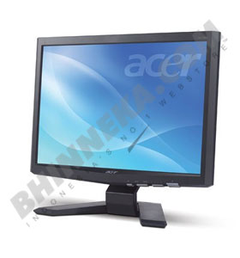
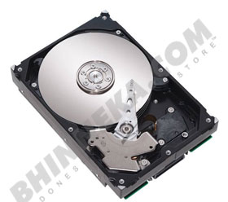

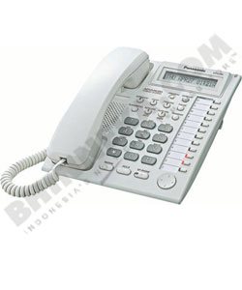
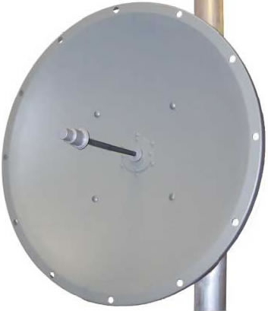



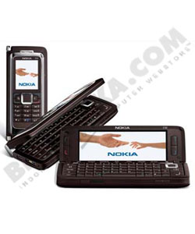

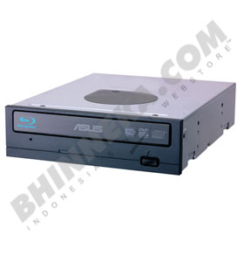
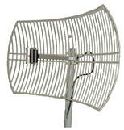
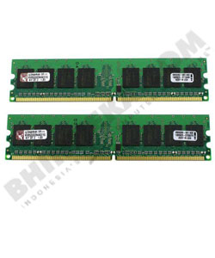
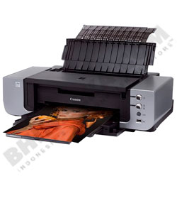

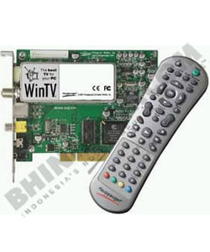

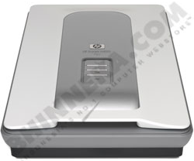

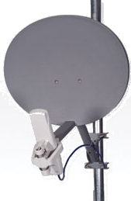
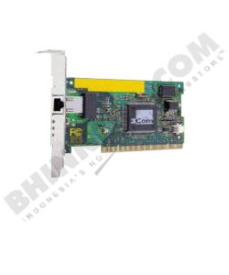
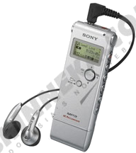
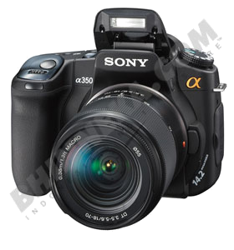
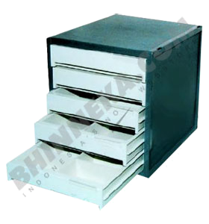
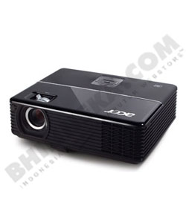
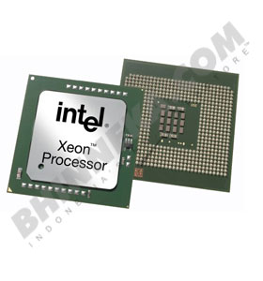
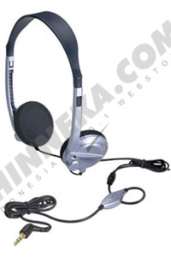

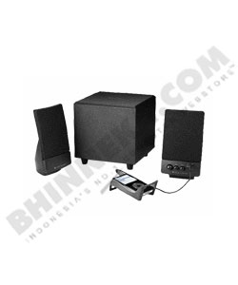
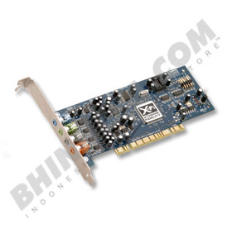

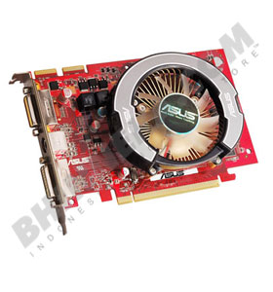



Slide 3
CENTRAL PROCESSING UNIT

Slide 4
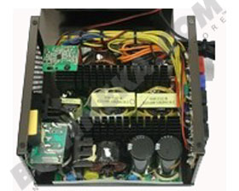
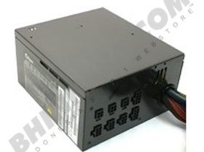
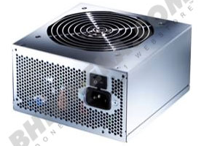

POWER SUPPLY

Slide 5
MOTHERBOARD

Slide 6
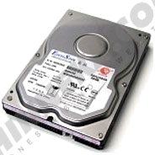
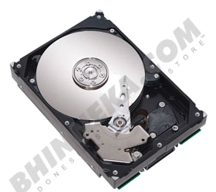
HARDDISK
EXTERNAL
INTERNAL

Slide 7
DVD/CD ROM

Slide 8
MEMORI

Slide 9
VGA CARD

Slide 10
SOUND CARD

Slide 11
PROCESSOR

Slide 12
LAN CARD PCI

Slide 13
KEYBOARD & MOUSE

Slide 14
SPEAKER AKTIF

Slide 15
WEB CAMERA

Slide 16
PRINTER

Slide 17
PRINTER PLOTTER

Slide 18
PROJECTOR

Slide 19
LAYAR PROJECTOR

Slide 20
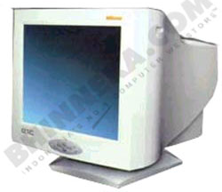

MONITOR
CRT
LCD
PLASMA

Slide 21
SCANNER

Slide 22

JOYSTICK

Slide 23

WIFI USB

Slide 24
TV TUNNER

Slide 25

DVD / CD

Slide 26
GPS

Slide 27
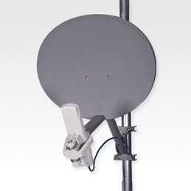

ANTENA WIRELESS
GRID
SEKTORAL
MOTOROLA

Slide 28

USB

Slide 29
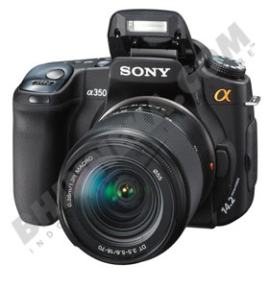
CAMERA DIGITAL

Slide 30
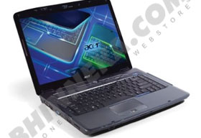
NOTEBOOK/LAPTOP

Slide 31
AKSES POINT WIFI

Slide 32
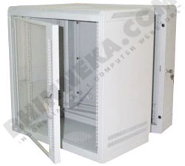
RAK SERVER

Slide 33

PESAWAT TELEPON
TELEPON
PABX

Slide 34


SERVER

Slide 35


HP & PDA
PDA
HANDPHONE

Slide 36
HUB/SWITCH

Slide 37
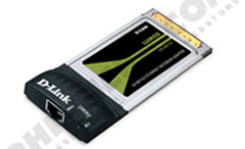
PCMCIA CARD

Slide 38

UPS

Slide 39
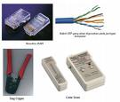
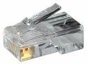
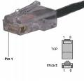


KABEL UTP & STP
KONEKTOR RJ45
KABEL UTP/STP

Slide 40







DESKTOP/PERSONAL COMPUTER

Slide 41
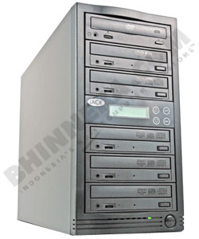
DVD/CD DUPLICATOR

Slide 42
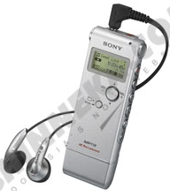
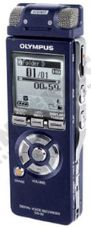
VOICE RECORDER

Slide 43
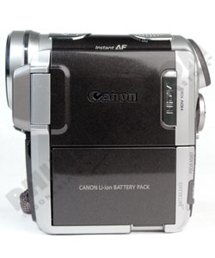
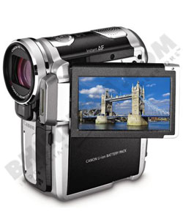

HANDY CAMERA

